Slide 1
Parable of
Week Three
New Cloth on an Old Coat
Parable New Cloth on an Old Coat.
Matthew 9:16; Mark 2:21 or Luke 5:36

Slide 2
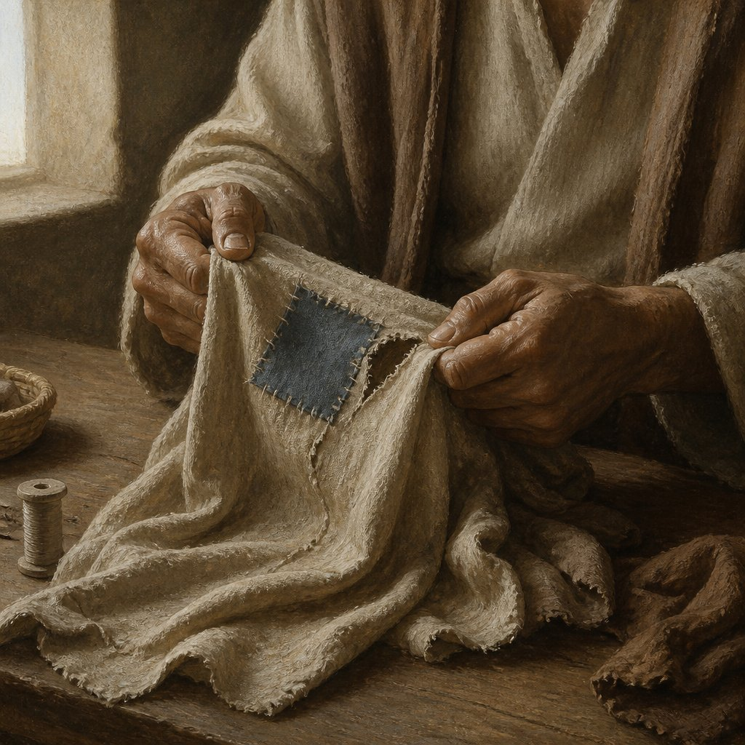
“No one sews a patch of unshrunk cloth on an old garment, for the patch will pull away from the garment, making the tear worse.
Mark 2:21 NIV

Slide 3
The parable of the new cloth on an old garment teaches that the radical, transformative message of Jesus cannot be contained by, or merely patched onto, rigid old religious traditions.
In Mark 2:21, the new cloth symbolizes Jesus’ fresh teachings, like fasting, His powerful presence as the bridegroom, and the new kingdom of God (vv. 18-20). These lessons cannot simply be patched onto the old religious system of the Pharisees or fit into the traditional patterns of the old covenant (vv. 21-22). Jesus used a familiar example: sewing a new patch onto an old garment would cause it to shrink, pull, and tear further. So, his teachings were not just a patch from the old ways (see Mark 2:2-17, 23-28)—they were truly something new (Greek: kainon), like an “unshrunk cloth,” offering a fresh perspective.

Slide 4
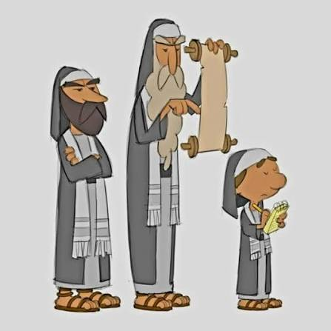

Old Garment: Likely symbolizes the Pharisaical religious system grounded in an old covenant framework, which emphasized human tradition and rigid legalism (cf. Mark 1:22, 2:24).
New Cloth: Plausibly represents the unprecedented, authoritative dimensions of Jesus’ ministry and revelation, breaking beyond the limitations of the old system (cf. Mark 1:27, 45).
Although Jesus' metaphors appear to address fasting, His message reaches far deeper. He is not merely commenting on the surface ritual but revealing a profound spiritual shift. Fasting, in this context, becomes a symbol of something greater: the incompatibility between the old covenantal forms and the new reality inaugurated by His presence. This same principle undergirds Paul's renewed view of circumcision - both fasting and circumcision are redefined considering the Gospel.

Slide 5
History
Fasting in the Mosaic law originates with the Day of Atonement - the only fast explicitly commanded by God (Leviticus 16:29-31, 23:27-32). It symbolized:
National repentance,
Humility, and
Purification before the Lord.
Now I will not assume that you understand what the Day of Atonement is, so here goes.

Slide 6
The Day of Atonement
The Day of Atonement, or Yom Kippur, is the highest holy day of the Jewish calendar. In the Old Testament, the high priest made an atoning sacrifice for the people's sins on the Day of Atonement. This act of paying the penalty for sin brought reconciliation (a restored relationship) between the people and God.
After the blood sacrifice was offered to the Lord, a goat was released into the wilderness to symbolically carry away the people's sins. This "scapegoat" was never to return.
The Day of Atonement was a yearly feast God instituted to completely cover (pay the penalty for) all the sins of the people of Israel.
When the Temple in Jerusalem was destroyed in 70 A.D., the Jewish people could no longer present the required sacrifices on the Day of Atonement, so it came to be observed as a day of repentance, self-denial, charitable works, prayer, and fasting.
Yom Kippur is a complete Sabbath. No work is done on this day. On Yom Kippur, the book of Jonah is read in remembrance of God's forgiveness and mercy.
Over time, fasting expanded into a broader spiritual practice in Israel, especially during times of national crises or personal grief. By Jesus' day, the Pharisees had institutionalized fasting as a regular discipline, twice a week. Luke 18:12 reflects this: a Pharisee boasts, "I fast twice a week." By then, the practice had drifted from its original intent, and the "old container" of the Mosaic framework no longer served its purposes.

Slide 7
John the Baptist's role was to prepare the way for Jesus. In John 3:28-30, he says.
“You yourselves can testify that I said, ‘I am not the Messiah but am sent ahead of him.’ 29 The bride belongs to the bridegroom. The friend who attends the bridegroom waits and listens for him and is full of joy when he hears the bridegroom’s voice. That joy is mine, and it is now complete. 30 He must become greater; I must become less.” (NIV)

Slide 8
From this testimony, John expected his disciples to turn their devotion toward Jesus. Yet instead of following the one to whom John pointed, they continued in their former practices - practices which, at times, resembled those of the Pharisees - and questioned why Jesus and His disciples were not fasting like they were. They were meant to become the new cloth and the new wine but remained confined within the old framework. Jesus responds by reminding them of the very imagery John used. In Mark 2:19-20 He says:

Slide 9
Jesus answered, “How can the guests of the bridegroom fast while he is with them? They cannot, so long as they have him with them. 20 But the time will come when the bridegroom will be taken from them, and on that day they will fast. (NIV)
If fasting represents sorrow or mourning, how could it be appropriate while the bridegroom - the source of joy - is present?
Jesus' emphasis in this passage is not primarily about fasting itself, but about the transformative power of His Gospel. The new life He brings cannot be contained within the old structures of the Mosaic framework - just as new cloth cannot patch an old garment, and new wine cannot be contained in old wineskins.

Slide 10
Jesus is not speaking against fasting, just as Paul does not reject circumcision outright. Rather, both are reframed. In Christ, believers are new creations - no longer bound by the burdens of ritual law. The Spirit now dwells within them, and their lives are marked by joy, holiness, and freedom. Fasting and circumcision become personal expressions of devotion, not covenantal requirements.
In this account, John’s disciples came to Jesus and asked, “Why do we and the Pharisees fast, but your disciples do not fast?” Jesus replied, “Can the wedding guests mourn while the bridegroom is with them?”
Fasting is often practiced to mourn our sins and foster spiritual self-discipline, helping us combat sin in our lives. While fasting has its significance and value, it is not meant for specific occasions, such as when the Lord Jesus shares moments with his disciples. However, he also says, “The day will come when I, the bridegroom, will be taken away from my disciples, and they will fast.”

Slide 11
Jesus explains that you should not patch an old garment with a new, unshrunk piece of cloth because, when the new cloth shrinks, it could tear the old fabric. Similarly, it is not a clever idea to put new wine into old wineskins that have lost their flexibility, because the fermentation process causes the new wine to expand and risk bursting the wineskin. Instead, store new wine in fresh, soft wineskins that can expand as the wine ferments. Back in ancient times, people often used animal skins instead of bottles to store water and wine.
Why does the Lord Jesus talk about a bridegroom, and then suddenly about a garment and wine? What is the connection between these images? He is clearly using picture language, but how are they linked? It is wonderful to see how beautifully they relate to each other. I always marvel at the Lord’s teaching.

Slide 12
These two elements — a new garment and new wine
are indispensable to a wedding. No one expects the bride or groom to arrive at their wedding in an antiquated garment with patches here and there. Wine is also always present at weddings as a symbol of joy. At the wedding in Cana, the wine ran out; Jesus performed his first miracle through God’s power by turning water into wine.

Slide 13
Garment and wineskin are pictures of human life.
When you study the Lord Jesus’ teaching but do not understand it, it is often because you are unfamiliar with the Old Testament. The principle is this: if you see something you do not understand, look for it in the Old Testament, and it may be explained there. If you do not understand what “garment” and “wineskin” mean, turn to the Old Testament, and there you will find them explained.
I hereby present several Old Testament references in which garments symbolize human life to help you understand the current passage: Isaiah 50:9, 51:8, 52:1, 61:10; Psalm 102:26.
(Take a break and look at the above Scriptures before progressing to the next information.
The Old Testament also depicts a wineskin as a symbol of human life.
In Job 32:19, the heart of man is illustrated as a wineskin: 'my heart is like a wineskin stretched to the point of bursting.' In
Psalm 119:83, the psalmist says he is like a wineskin blackened with smoke. In
Jeremiah 13:12–13, the inhabitants of Jerusalem are likened to wineskins.
(Take a break and look at the Scriptures above before moving on to the next information.)

Slide 14
Warning:
You cannot patch the new with the old.
Adding Patches
The Pharisees might have been fine with Jesus if he had simply made small adjustments, mending a few parts of Judaism as they practiced it. However, Jesus explained to them and his disciples that only a completely new set of clothes would do the trick. Just patching up the old would only lead to a situation even more troublesome than before.
What message does this hold for me today? It informs me that the individual I was upon embracing Christianity is not compatible with living in the Spirit. Merely making slight adjustments to my life, applying superficial improvements or cosmetic enhancements—will not suffice. If the core of who I am internally remains unaltered, all patching efforts will inevitably prove futile. Constantly repairing my life will lead to frustration and defeat. As long as the original self remains central, the struggles will persist indefinitely. Simply washing a pig will not keep it from rolling in the mud; it must be transformed into something else to stay clean.
Be Transformed, Not Conformed
In Romans 12:2, Paul warmly encourages us not just to follow the world's patterns but to be genuinely transformed by renewing our minds. I also see this as the message Jesus shared with the Pharisees in this situation. Instead of patching up the old self, we must embrace deep, heartfelt transformation. We need to let go of our old ways and be reborn through the Spirit. When we accept the new life the Spirit offers, we need no superficial fixes, because this transformation lets us fully experience the life He has designed for us.
You might notice that some people in our community wear clothes that need mending. While this can be okay as a fashion statement, it's more concerning when, as Christians/Believers, we wear the 'garments of sin' and take pride in them.

Slide 15
Ephesians & Colossians
The Apostle Paul
Little religion will not surface in the long haul!
In Ephesians 4:22 and Colossians 3:9, Paul encourages us to 'Put off the old self,” which represents our former nature, and to 'put on the new self,' reflecting God's likeness. Becoming a Christian or Believer is not simply about fixing up your old character with a little faith. It is about a heart-changing transformation—letting go of the old self and embracing the new. As Paul beautifully explains in 2nd Corinthians 5:15–17, being a Christian means more than adding a bit of religion to who you used to be; it is about becoming a completely new person.
Which is more wonderful: turning water into wine or transforming a sinner into a saint? Both are truly remarkable, but which one holds more significance? I believe that transforming a sinner into a saint is more meaningful. Turning water into wine symbolizes something even deeper and more important: transforming your life's character. If you've experienced God’s power to change your life, you are already on the path to knowing Him.
Becoming a Christian is about more than just adding a little religion to your life. You feel like your life is incomplete and empty, with a hole here and a hole there. You might think that by turning to Christianity, you can fill these emptiness’s. But Jesus reminds us that if we try to patch up our lives in this way, our situation may become worse than before. Try it, and you will see that the Lord Jesus knows what He's talking about.
Certain individuals, upon hearing the gospel, tend to accept the aspects they find agreeable while rejecting those they find objectionable. They often state, “I appreciate this part but not the section regarding complete commitment. A modest amount of religion is beneficial, but excessive involvement may lead to fanaticism.” It is common to hear remarks such as, “Attending church once a week is acceptable; however, twice a week is excessive.”

Slide 16
The JUNK in the CHURCH
Destitute Individuals
New STYLE! Righteousness or Unrighteousness?
The church is filled with destitute individuals. If one observes someone dressed in garments with numerous patches, what conclusion might be drawn? That he is a beggar. Nevertheless, people attend church and declare, “I like that part of the message, so I will patch my hole with it. But the other part of the message is too strong for me; I cannot take it.”
Some individuals take pride in their patches. Patched jackets and, notably, torn jeans represent the latest fashion trend; furthermore, these items tend to be more costly than their unpatched counterparts. I recall asking a salesperson, “Why do you sell this old junk at a higher price than the new clothing?”
He said, “It’s not old junk, it’s new!”
I said, “Why then is it all patched up?”
“That’s the new style.”
“But why is it more expensive when it’s all patched up?”
He said, “You must pay for the labor. It takes work to stitch the patches together. And after stitching them, you must tear the fabric by hand to give it a torn look.

Slide 17
Inverted World
New will Tear the Old
This world seems radically inverted. You must pay more for rags than for quality garments. Additionally, you must pay extra for the labor of tearing your pants. Some individuals even believe dirty pants have greater aesthetic appeal. Similarly, some Christians today take pride in their fragmented faith and consider it aesthetically pleasing.
In the teachings of the Lord Jesus, if one wishes to be a true Christian or Believer, it is important not to select and reject specific parts of the gospel based on personal preference. At first, a selective approach may seem satisfactory, but it proves detrimental when challenges arise. What occurs when the superficial adhesion begins to dry? The unshrunk cloth will start to shrink and may cause tears. Consequently, this phenomenon contributes to numerous casualties within the church. Many individuals attend church to choose aspects of the gospel that appeal to them, but after two or three years, they often become spiritually torn and confused.

Slide 18
The Lord Jesus states, “You cannot take the salvation I offer in segments. Accept it wholly or not at all." The gospel has such profound power that even a small fragment can wield enough influence to cause considerable distress to one's old nature. One might argue, “If I indulge too much in the gospel, I risk becoming a fanatic; therefore, I will only take a small portion that will not cause harm." However, ultimately, this small portion can make someone who is "one-quarter" or "three-quarters" Christian feel uncomfortable. I have observed individuals engaging in this behavior, and they are consequently experiencing repercussions. At that point, assisting them becomes exceedingly difficult. I reiterate, the gospel is immensely powerful, and it should not be treated superficially.

Slide 19
The Lord emphasizes that the new wine of the gospel cannot be contained in one's old life, because it has transformative power. It will expand and inevitably rupture the confines of old life, leading to its dissolution. The old life is incompatible with the gospel; one cannot indulge in sin and maintain belief in the gospel at the same time. Similarly, a life characterized by pride and self-centeredness cannot coexist with genuine faith. Only through a sincere admission, such as, “Lord, change me completely; I will put away my sins and my old life,” can an individual receive the new wine of the gospel.

Slide 20
I hope that when we share the gospel, we focus on God's power rather than just religion. I am not asking you to join a specific religion or to appear holy outwardly. What I want to share is that the gospel is God’s power bringing salvation. You cannot save yourself, but God can. When you experience His power, you will utterly understand what we have been talking about.
New wine, new garment: Joy in the Holy Spirit
New clothes also symbolize joy. Wine also pictures joy in the Bible. Just as wine makes the heart cheerful, you have joy when the Holy Spirit of God comes into your life.

Slide 21
Key Elements and Symbolism
The New Cloth (Unshrunk fabric): Represents the grace, freedom, and new covenant brought by Jesus. Because it is unwashed and unshrunk, it carries active, dynamic power.
The Old Garment: Symbolizes the rigid, legalistic religious system, human traditions, and ceremonial laws of the Pharisees.
The Action (Sewing new onto old): Attempting to mend the worn-out, legalistic system with Christ's radical new teachings.

Slide 22
The Core Lessons & Lessons
Incompatibility: Just like a new, unshrunk patch can shrink and tear away from old, fragile fabric—making the hole worse—Christ's teachings don't quite fit into the old framework.
Complete Renewal – A New Covenant: Jesus did not come merely to 'patch up' or modify older religious practices, such as ritual fasting rules; rather, He arrived to provide a comprehensive spiritual transformation and a completely new mode of living.
Regarding the New Covenant: Jesus did not come solely to 'patch up' Judaism or antiquated religious customs; instead, He introduced an entirely novel approach to salvation through faith and grace.
Personal Application: Trying to follow Christ while clinging to old, inflexible ways or dead traditions ruins the spiritual growth meant to happen in a believer's life.

